Slide 1

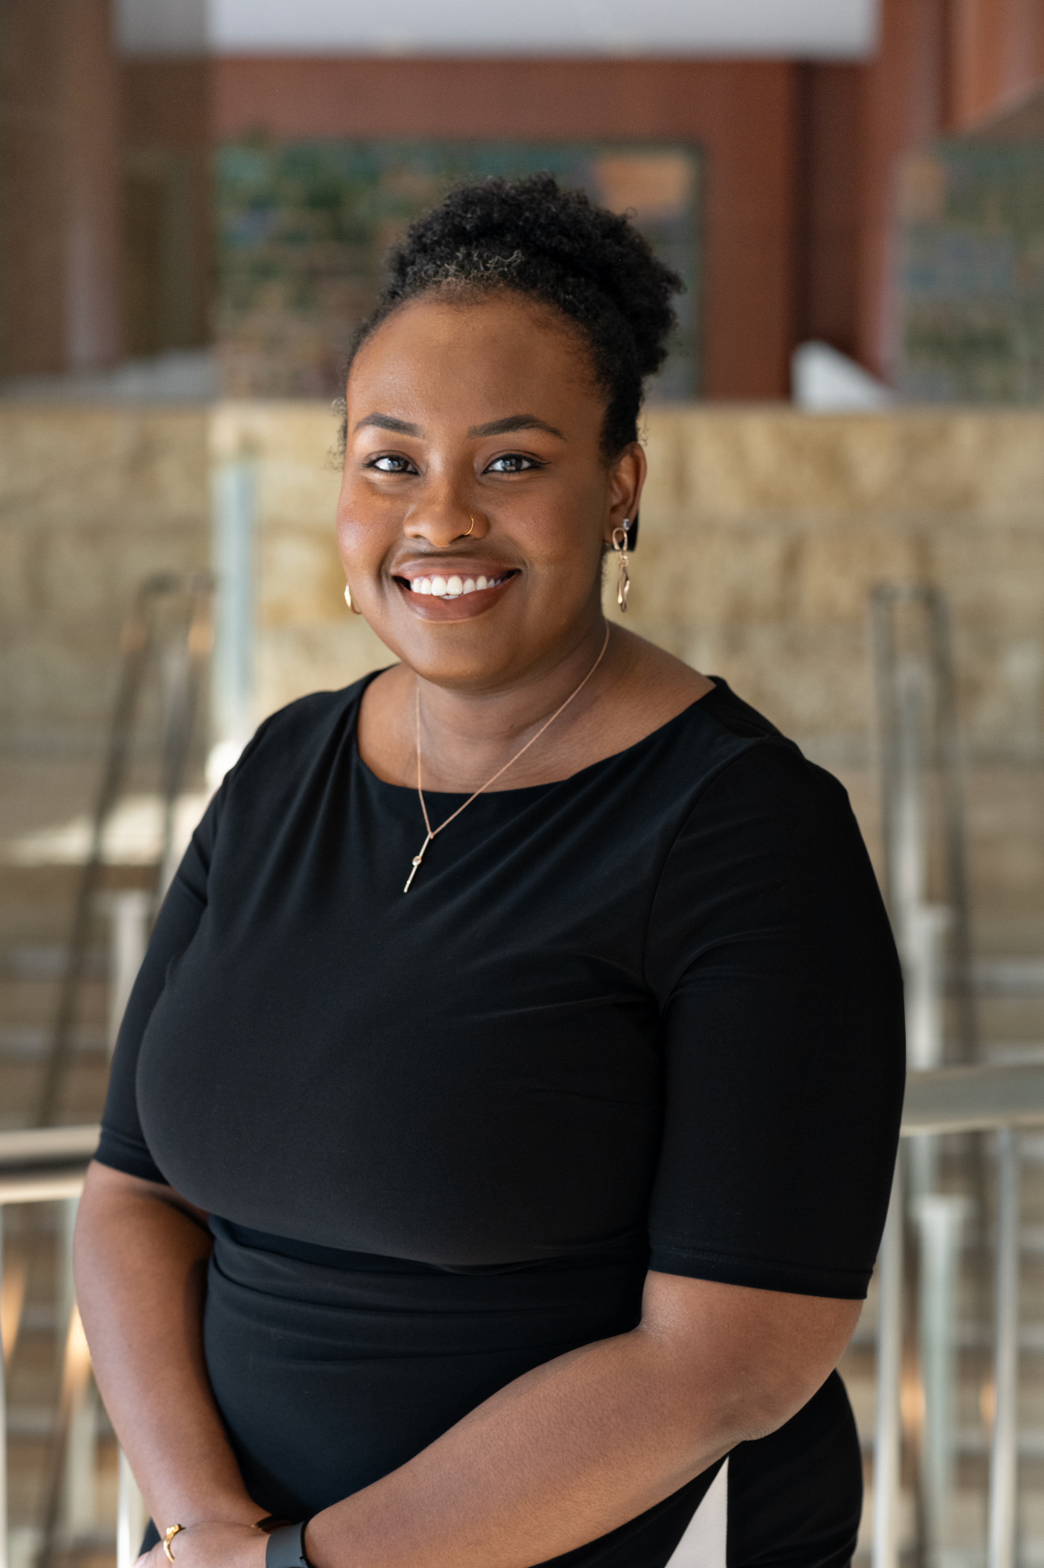

Applied Economics (APEC) Student Seminar
Monique Davis
PhD Student
Wednesday,
February 28
12 PM – 1 PM
Ruttan Hall 119
https://umn.zoom.us/j/97156270931
Title:
School Resource Officer Selection and Training on Racial Disparities in Exclusion
Food and Beverages will be provided. Reach out to the organizer (Ryan McWay) if you have any questions: mcway005@umn.edu

